Slide 1
Team TBA’s
Recycling Sorter
Daniel Rose, Nicholas Connolly, Nicole Kresse,

Slide 2
Project Overview
The goal is to create a sufficient alternative to how we recycle materials, by infusing several can and bottle machines into one. The system will identify items properly and discard it into appropriate bins. If bins are full, operators will empty the bins and allow the system to continue its operation.
One of the major reasoning behind this system is to replace trash and recycling bins out in the street as people will throw away trash into any bin possible. Not only will the construction of this system allow for elimination of recyclable materials in landfills but also decrease the amount of labor workers needed to separate recyclable materials at recycling centers.

Slide 3
Technology Used
Hardware:
Raspberry Pi 4
Pi Camera (or USB Camera)
Arduino
Rail System
Servo Motors
Parallax Feedback 360 High-Speed Servo
Distance sensors
Load Cells
FSR01CE
Software
OpenCV / Tensorflow
Python (Raspberry Pi)
WiringPi library no longer available
Arduino
Write code to control the motors based on input from Raspberry Pi

Slide 4
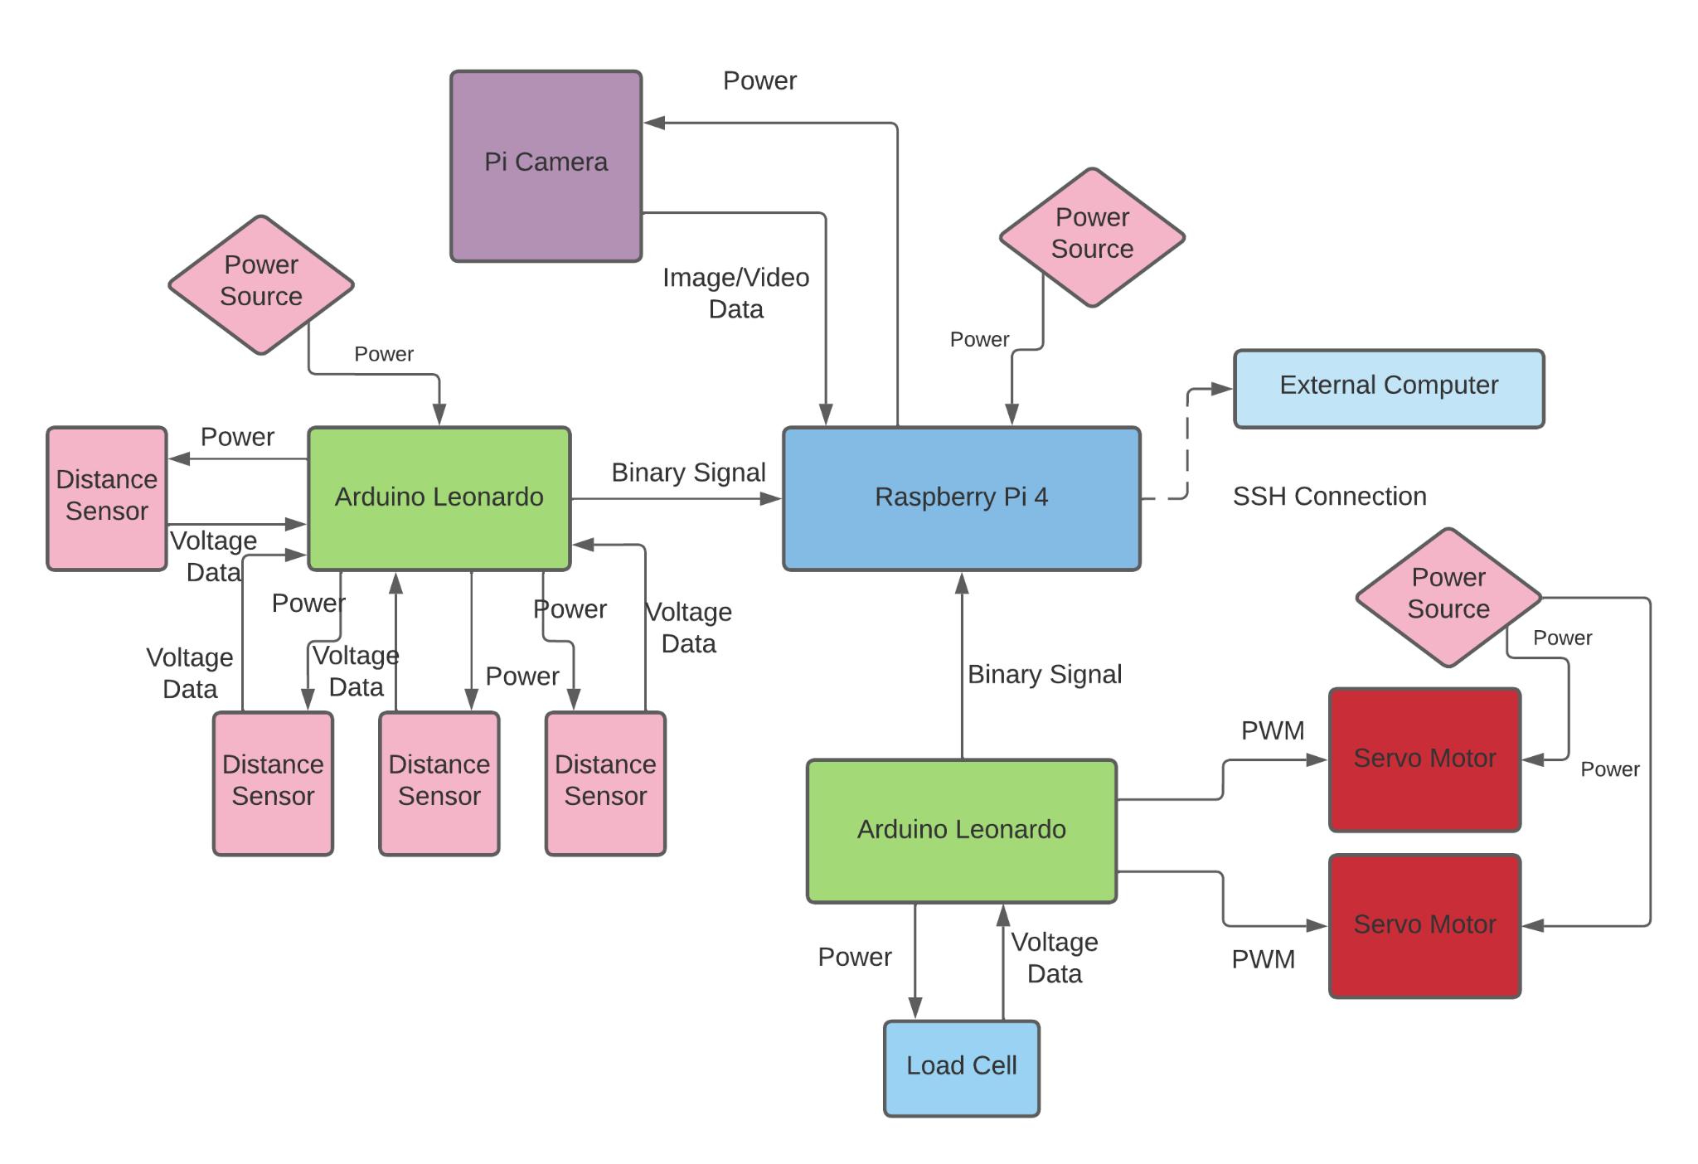
Final Block Diagram

Slide 5
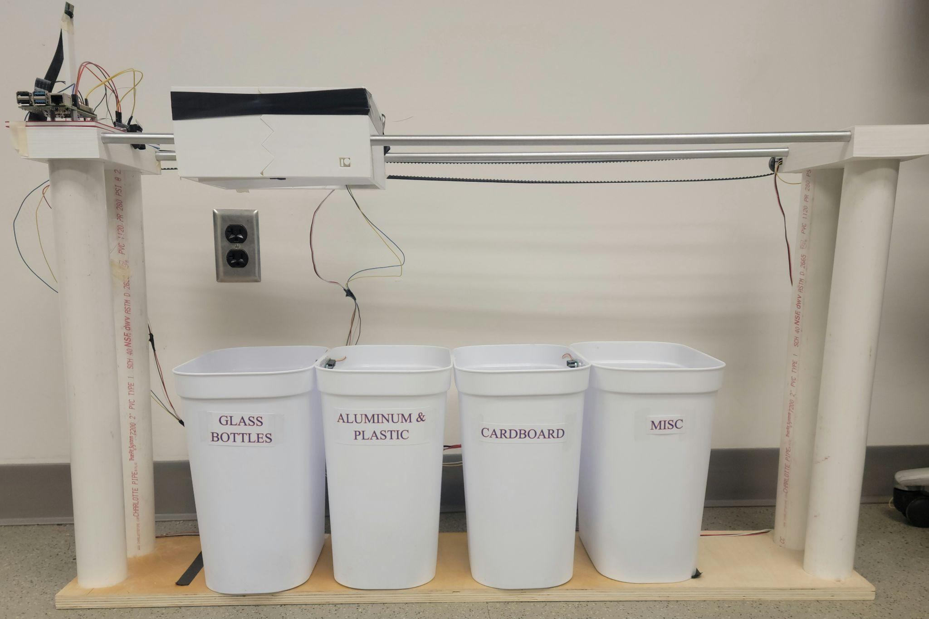
Current State
Load Cells
Arduino detects when item is inserted using load cell values
Arduino sends signal indicating object is present
If threshold is passed it will indicate object is glass (only used for bottle classification)
Image/Video Processing
First, the Raspberry Pi will use Video Processing to see if a bottle is present in the carriage
If a bottle is not detected in the first 5 iterations, the raspberry Pi will take an image and count the total number of pixels inside our HSV range
If the threshold is not passed, object will be classified as miscellaneous
Classification is sent back to Arduino
Carriage Movement
Given the classification information, the Arduino will move the carriage over the corresponding bin. This is done with continuous servo motors attached to a belt
Once over the correct bin, the Arduino will activate the trap door, dropping the item into its bin
Finally, the Arduino will run the motor until it trips the limit switch, indicating it has reached the base location.

Slide 6
Video Demo

Slide 7
Future State
Bin System
Integrate with Raspberry Pi code to indicate when the bins are full
Belt Movement
Improve Belt movement by adding a belt tentioner
Can detection
Improve reliability of Can detection by training an ML model

